Slide 1
Job Shop Scheduling Problem using Genetic Algorithm, Simulated Data
Shi Yuanjie, Chen Junjie

Slide 2
CATALOG
Job shop scheduling problem(JSP)
Genetic algorithm
GA toolbox
Gantt chart
Results
Improvements
Reference

Slide 3





JSP-problem description
How to arrange the production order?

Slide 4
JSP-restrictions
(1) Each product needs to go through processing sequence.
(2) Each processing sequence of the product can only be completed on the specified machine.
(3) Each processing sequence must comply with the requirements of the processing technology. After the previous one is completed, the next step is allowed.
(4) When each processing sequence is stopped after starting, it cannot be interrupted halfway.
(5) There is no priority between products.
(6) A product can only be processed once by one machine.

Slide 5
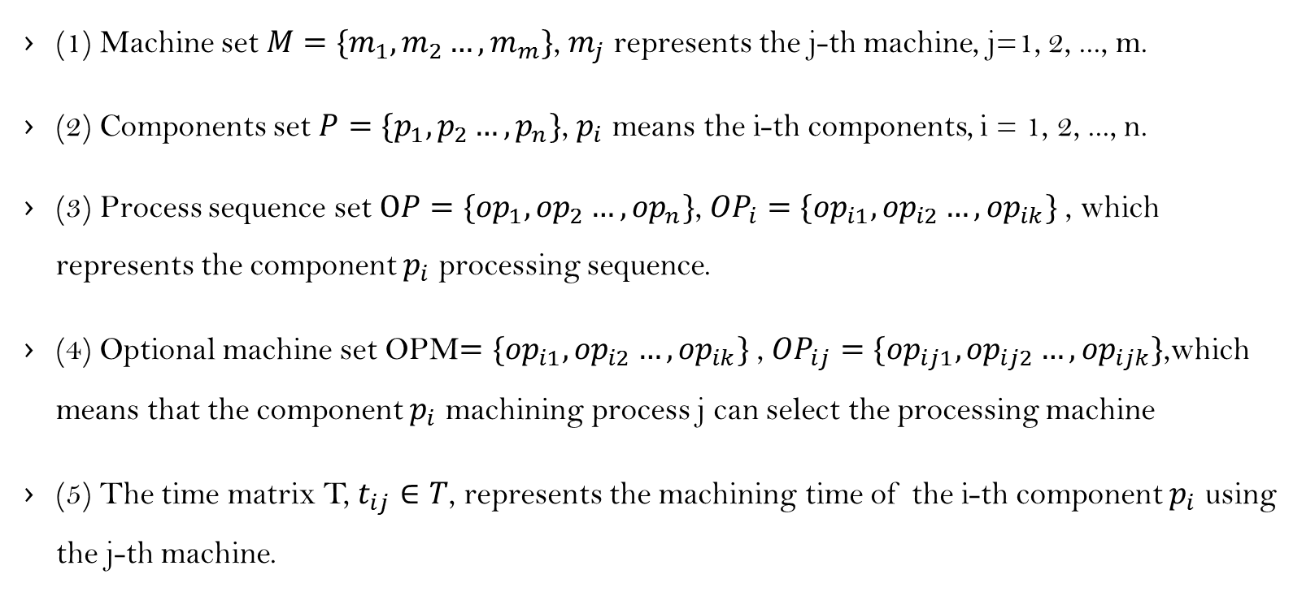
JSP- math model parameters
(1) Machine set$M=\{m_{1},m_{2}…,m_{m}\}$, $m_{j}$ represents the j-th machine, j=1, 2, ..., m.
(2) Components set $P=\{p_{1},p_{2}…,p_{n}\}$, $p_{i}$ means the i-th components, i = 1, 2, ..., n.
(3) Process sequence set $OP=\{{op}_{1},{op}_{2}…,{op}_{n}\}$, ${OP}_{i}=\{{op}_{i1},{op}_{i2}…,{op}_{ik}\}$ , which represents the component $p_{i}$ processing sequence.
(4) Optional machine set OPM$=\{{op}_{i1},{op}_{i2}…,{op}_{ik}\}$ , ${OP}_{ij}=\{{op}_{ij1},{op}_{ij2}…,{op}_{ijk}\}$,which means that the component $p_{i}$ machining process j can select the processing machine
(5) The time matrix T, $t_{ij}∈T$, represents the machining time of the i-th component $p_{i}$ using the j-th machine.

Slide 6
Genetic Algorithm-flow
Initialize parameter and randomly generated initial population
Calculate the initial population fitness
Output the optimal result
Does it satisfy the loop number?
Yes
No
Select
Crossover
Mutate
Calculate the new population fitness and replace the original one
Record optimal results

Slide 7
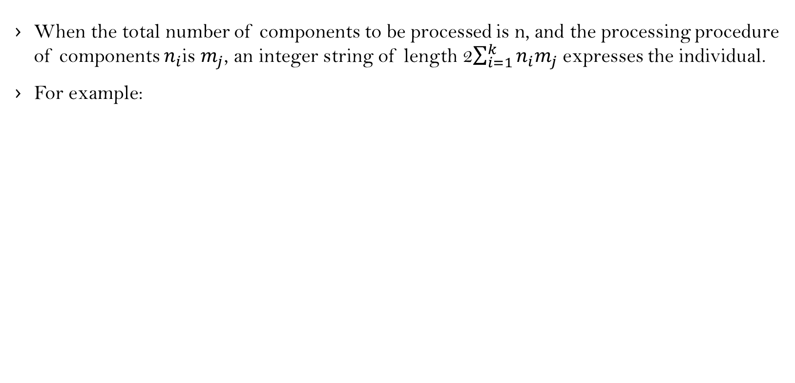
Genetic Algorithm-initialize
When the total number of components to be processed is n, and the processing procedure of components $n_{i}$is $m_{j}$, an integer string of length 2$\sum_{i=1}^{k}{n_{i}m_{j}}$ expresses the individual.
For example:
processing machine
2 | 4 | 3 | 1 | 1 | 2 | 3 | 4 | 2 | 1 | 3 | 3 | 2 | 2 | 1 | 3
processing order

Slide 8
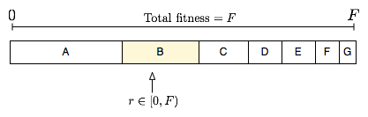
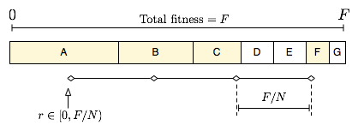

Genetic Algorithm-select
Roulette wheel selection
stochastic universal selection
$P\left(x_{i}\right)=\frac{fitness(x_{i})}{\sum_{i−1}^{k}{fitness(x_{i})}}$
SUS(Population, N)
F := total fitness of Population
N := number of offspring to keep
P := distance between the pointers (F/N)
Start := random number between 0 and P
Pointers := [Start + i*P | i in [0..(N-1)]]

Slide 9

Genetic Algorithm-crossover
First randomly selects two chromosomes from the population.
Then, extracts the top $\sum_{i=1}^{k}{n_{i}m_{j}}$ bits of each chromosome.
Next, randomly selects the cross positions to cross.
Last, according to the operating machine before crossover adjust the crossed machine
select to cross
adjust machine
2 | 4 | 3 | 1 | 1 | 2 | 3 | 4 | 2 | 1 | 3 | 3 | 2 | 2 | 1 | 3
parents
1 | 2 | 4 | 3 | 2 | 4 | 1 | 2 | 3 | 1 | 1 | 1 | 2 | 3 | 3 | 2
1 | 2 | 4 | 3 | 2 | 4 | 1 | 4 | 3 | 1 | 1 | 1 | 2 | 3 | 3 | 3
children
2 | 4 | 3 | 1 | 1 | 2 | 3 | 2 | 2 | 1 | 3 | 3 | 2 | 2 | 1 | 2
processing order
processing machine

Slide 10
Genetic Algorithm-mutate
First, randomly selects the individual from the population
Then, selects the variation positions pos1 and pos2,
Next, swaps the processing steps of the pos1 and pos2 bits in the individual.
Finally, the process the corresponding machine orders.
1 | 4 | 2 | 3 | 2 | 4 | 3 | 4 | 3 | 1 | 1 | 1 | 2 | 3 | 1 | 3
variation positions
1 | 2 | 2 | 3 | 4 | 4 | 3 | 4 | 3 | 1 | 1 | 1 | 2 | 3 | 1 | 3
Machine orders
1 | 2 | 2 | 3 | 4 | 4 | 3 | 4 | 1 | 1 | 1 | 3 | 2 | 3 | 1 | 3
processing order
processing machine

Slide 11
Genetic Algorithm-pros&cons
1. Fast and random search capabilities.
2. With potential parallelism, multiple individuals can be compared at the same time.
3. Search using the evaluation function inspired, the process is simple
4. Use probabilistic mechanisms to iterate, with randomness.
5. Extensible, easy to integrate with other algorithms
1. complicated programming.
2. It requires many parameters and the choice of them seriously affects the quality of the solution. But now it is impossible to obtain the parameters using the formula.
3. There is no feedback information that can make use of the network in time. Therefore, the search speed of the algorithm is slow.
4. The algorithm has a certain dependence on the initial population selection.
5. In practical applications, genetic algorithms are prone to premature convergence.

Slide 12
GA toolbox
(1) ranking function: Sort-based fitness allocation
FitnV = ranking(OjbV)
(2)reins function: reinserting children generation into populations
Chrome = reins(Chrome, SelCh)
(3)select function: select individuals from the population
SelCh = select(SEL_F, Chrome, FinV)
(4)rws function: roulette wheel selection
NewChrIx = rws(FitnV, Nsel)
(5)sus function: stochastic universal selection
NewChrIx = sus(FitnV, Nsel)

Slide 13
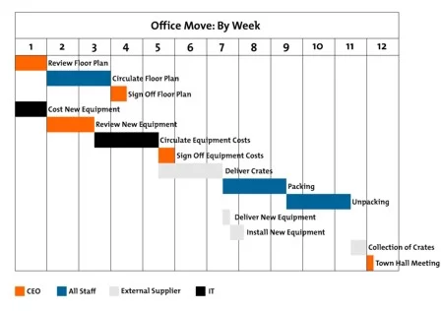
Gantt chart

Slide 14
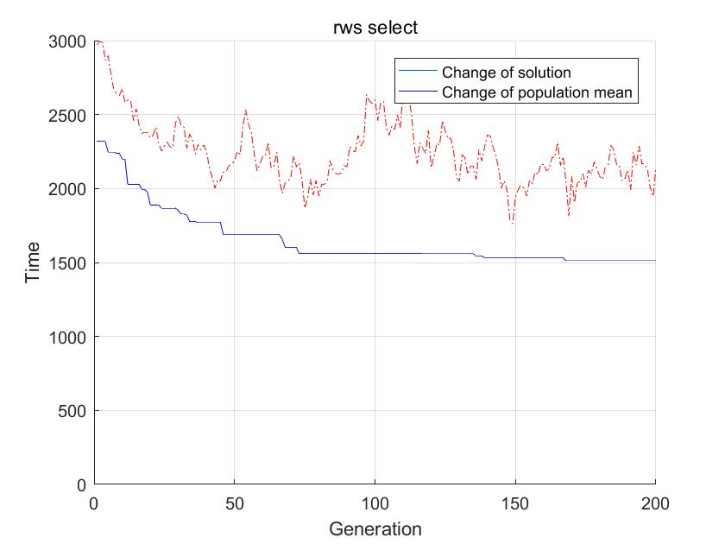
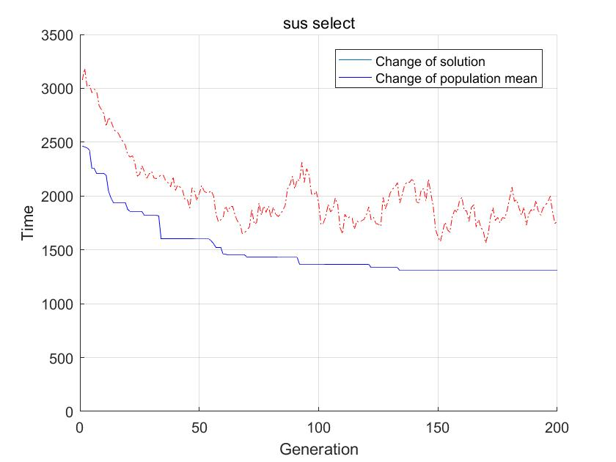
Results-change of solution

Slide 15
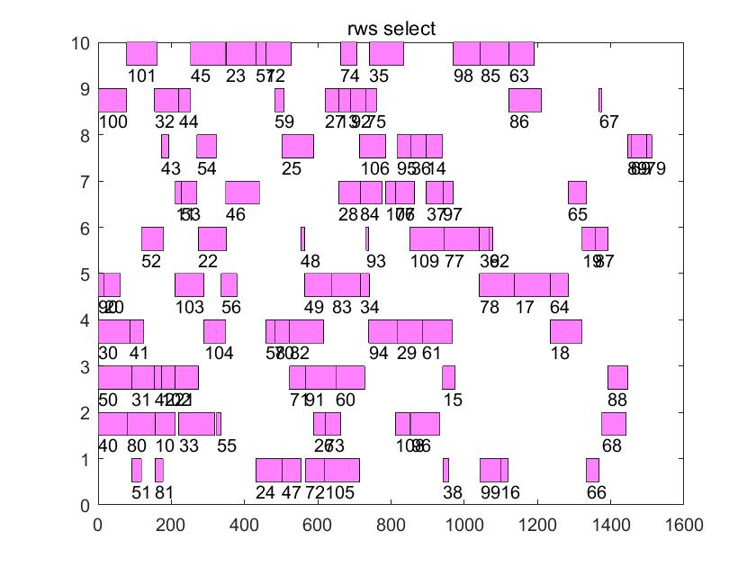
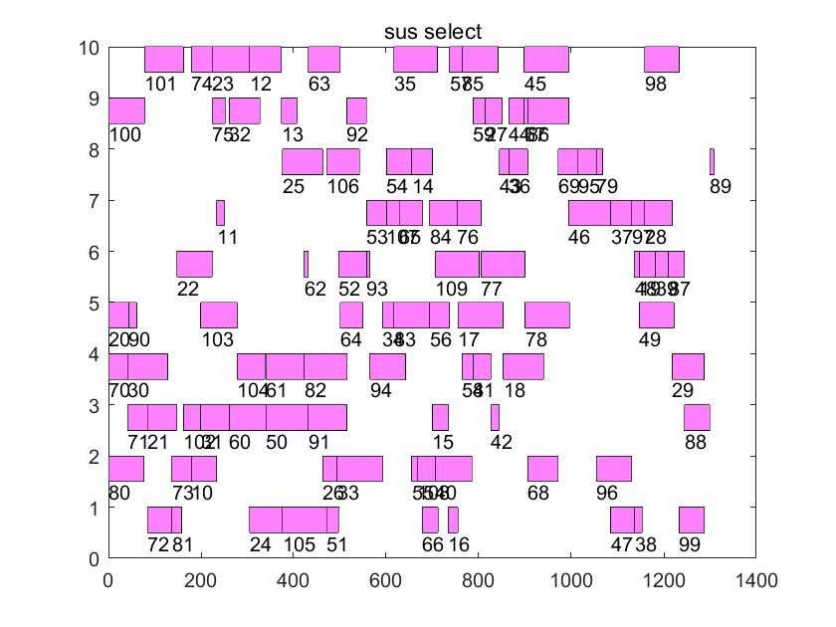
Results-Gantt chart
rws

Slide 16
Improvements
Use the improved genetic algorithm:
A crossover probability will not be set, but will be selected through a series of individual fitness value determinations.
A mutation probability will not be set, but will be selected through a series of individual fitness value determinations.
Mixed with other algorithms:
Simulated annealing algorithm controls variation and selection. By this way parents and children compete to find the global optimal solution.
Greedy algorithm finds the fastest optimization direction of the algorithm, improves the search speed, and reduces the time-consuming.

Slide 17
Reference
Genetic algorithm toolbox for use with MATLAB
Principles and Applications of Genetic Algorithms

Slide 18
Thank you !

